Slide 1



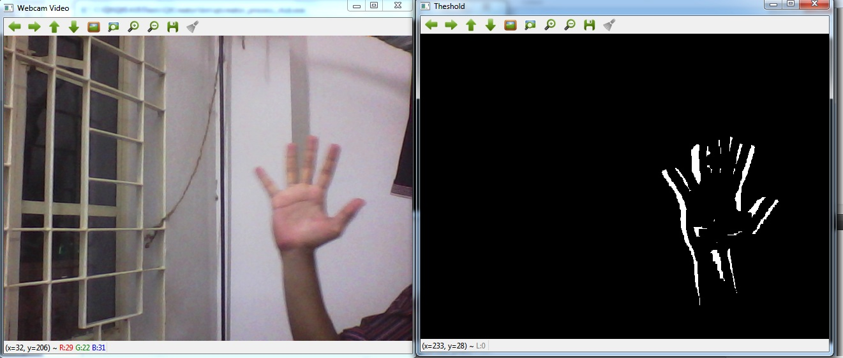
Session 8 :
Introduction to Motion Detection

Slide 2

Introduction
Motion Detection involves identifying movement in a video stream by comparing changes across frames.
It is crucial for applications such as surveillance, robotics, and smart environments.

Slide 3
Learning Outcome
Learn how to detect moving objects in real-time video using background subtraction techniques.
Gain foundational knowledge in foreground extraction and video analysis.

Slide 4
Programming Task Overview
Write a Python script using OpenCV to:
- Capture live or prerecorded video.
- Apply background subtraction (MOG2).
- Highlight and track motion with bounding boxes.

Slide 5
Why It Matters
Motion detection is central to:
- Surveillance: Detecting intruders in security systems.
- Automation: Activating lights or alarms based on movement.
- Interaction: Gesture-based control in smart interfaces.

Slide 6
Python code : Real-World Example
1. Security Systems: Identifying and tracking intruders via CCTV.
2. Wildlife Monitoring: Tracking animal movement in nature reserves using fixed cameras.

Slide 7
Understanding Background Subtraction
Background subtraction isolates motion by comparing each frame with a background model.
Popular method: cv2.createBackgroundSubtractorMOG2

Slide 8
Preprocessing Video Frames
To enhance accuracy:
- Convert frames to grayscale.
- Apply Gaussian blur to reduce noise.
These steps make motion detection more reliable.

Slide 9
Implementing Motion Detection in OpenCV
Key Steps:
1. Apply background subtractor → obtain foreground mask.
2. Find contours in the mask.
3. Draw bounding boxes around moving objects.
4. Display processed video frames in real-time.

Slide 10
Visualizing Motion
Use contour detection to:
- Identify areas of motion.
- Draw bounding rectangles using cv2.boundingRect.
- Track motion clearly and effectively on screen.

Slide 11
Tuning Detection Parameters
Adjust MOG2 settings for optimal results:
- History: Affects how long background is retained.
- VarThreshold: Sensitivity to motion.
Fine-tuning reduces false positives and increases robustness.

Slide 12
Python Code :
Motion Detection
Real-Time Motion Detection with Sensitivity Control

Slide 13
Objective & Overview
Objective:
- Detect motion in a video stream
- Allow sensitivity adjustment via trackbar
- Visualize motion using bounding boxes
Tools:
- OpenCV
- Background subtraction
- Real-time processing

Slide 14
Background Subtraction & Capture
Background Subtraction:
- Use cv2.createBackgroundSubtractorMOG2
- Set history=500 for temporal smoothing
Video Capture:
- Open video or webcam using cv2.VideoCapture
- Check for successful initialization

Slide 15
Trackbar & Frame Processing
Trackbar Setup:
- Create 'Variance' trackbar (0–100)
- Controls the Vat Threshold for motion sensitivity
Frame Processing:
- Apply background subtractor to get foreground mask
- Reduce noise using cv2.morphologyEx (opening, 3x3 kernel)

Slide 16
Motion Detection & Display
Contour Detection:
- Detect contours in the mask using cv2.findContours
- Filter contours by area > 500 to ignore noise
Bounding Boxes:
- Use cv2.boundingRect and cv2.rectangle to highlight motion
- Display results with cv2.imshow and exit on 'q' key
- Release video and destroy windows after loop

Slide 17

Python Script on Motion Detection
PART 1
import cv2
import numpy as np
def nothing(x):
pass

Slide 18
Python Script on Motion Detection
PART 2
subtractor = cv2.createBackgroundSubtractorMOG2(history=500)
cap = cv2.VideoCapture('video.mp4')
if not cap.isOpened():
raise ValueError("Video not found!")
cv2.namedWindow('Motion Detection')
cv2.createTrackbar('Variance', 'Motion Detection', 25, 100, nothing)

Slide 19
Python Script on Motion Detection
PART 3
while True:
ret, frame = cap.read()
if not ret:
break
var_thresh = cv2.getTrackbarPos('Variance', 'Motion Detection')
subtractor.setVarThreshold(var_thresh)
mask = subtractor.apply(frame)
mask = cv2.morphologyEx(mask, cv2.MORPH_OPEN, np.ones((3,3), np.uint8))
contours, _ = cv2.findContours(mask, cv2.RETR_EXTERNAL, cv2.CHAIN_APPROX_SIMPLE)

Slide 20
Python Script on Motion Detection
PART 4
for contour in contours:
if cv2.contourArea(contour) > 500:
x, y, w, h = cv2.boundingRect(contour)
cv2.rectangle(frame, (x, y), (x+w, y+h), (0, 255, 0), 2)
cv2.imshow('Motion Detection', frame)
if cv2.waitKey(1) & 0xFF == ord('q'):
break
cap.release()
cv2.destroyAllWindows()

Slide 21
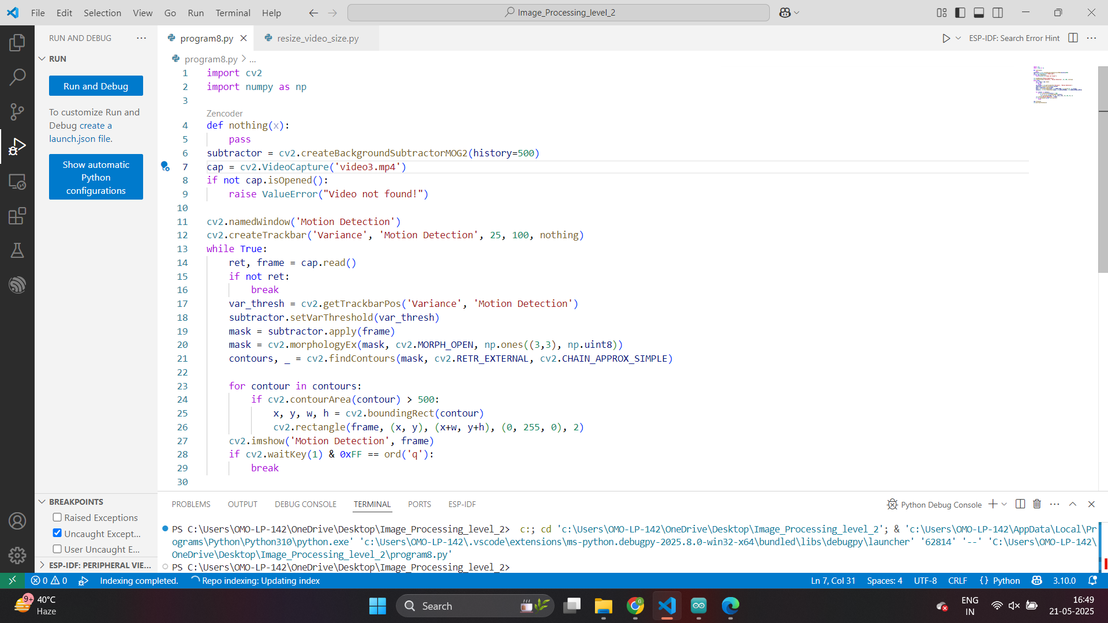

Slide 22
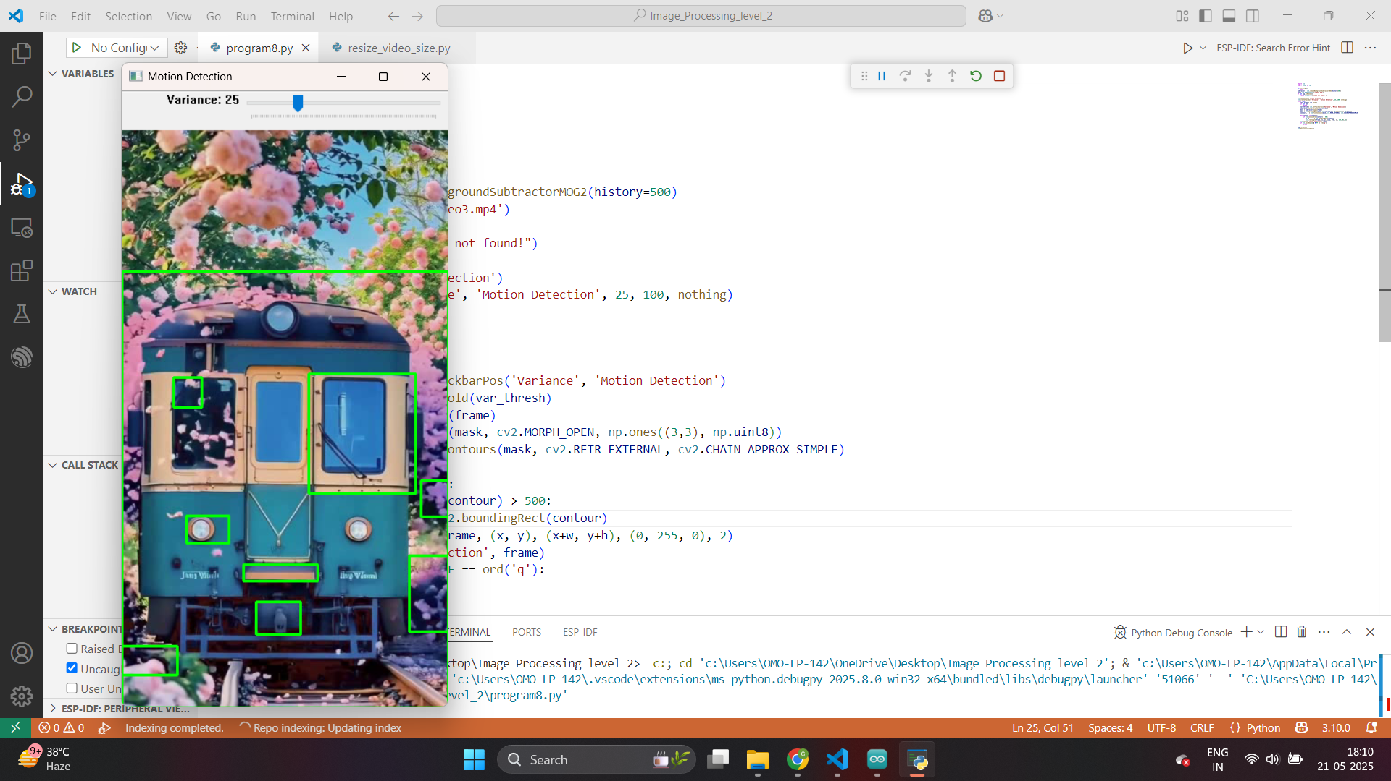

Slide 23
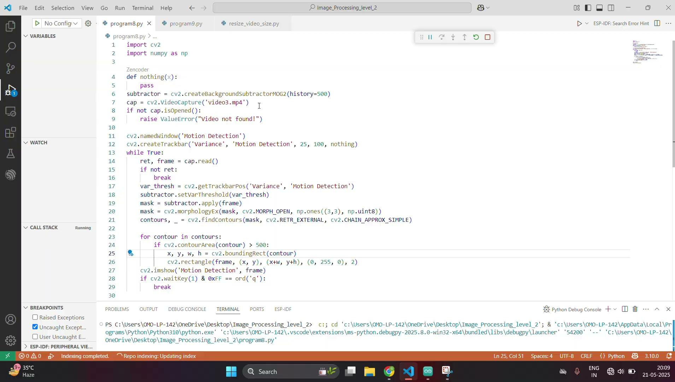

Slide 24
Exercise
1. What is the primary technique used in the motion detection script from this chapter?
A. Optical Flow
B. Background Subtraction (MOG2)
C. Edge Detection
D. Template Matching
Answer: B
2. What OpenCV function is used to create the background subtractor?
A. cv2.subtractBackground()
B. cv2.BackgroundSubtractor()
C. cv2.createBackgroundSubtractorMOG2()
D. cv2.backgroundMOG()
Answer: C

Slide 25
Exercise
3. What preprocessing steps are recommended for more reliable motion detection?
A. Convert to HSV and use Sobel
B. Convert to grayscale and apply Gaussian blur
C. Convert to RGB and use sharpening
D. Apply median blur and invert colors
Answer: B
4. What is the purpose of using cv2.morphologyEx() with the foreground mask?
A. To increase contrast
B. To create edges
C. To reduce noise
D. To sharpen details
Answer: C

Slide 26
Exercise
5. What does the 'Variance' trackbar control in the application?
A. Camera zoom
B. Frame rate
C. Motion sensitivity (VarThreshold)
D. Image resolution
Answer: C
6. What value of contour area is typically used to filter out noise?
A. 1000
B. 100
C. 10
D. 500
Answer: D

Slide 27
Exercise
7. What is used to visualize detected motion on the video frames?
A. Lines
B. Bounding Boxes
C. Color histograms
D. Text overlays only
Answer: B
8. What is the role of the cv2.VideoCapture() function?
A. Draw bounding boxes
B. Access webcam or video input
C. Apply filters
D. Detect background
Answer: B

Slide 28
Exercise
9. What happens when the ‘q’ key is pressed in the OpenCV loop?
A. The video resets
B. The mask is cleared
C. The program exits the loop
D. The bounding boxes disappear
Answer: C
10. Which of the following is NOT a real-world use of motion detection mentioned in the slides?
A. Wildlife Monitoring
B. Smart Lighting
C. Document Scanning
D. Security Systems
Answer: C

